Slide 1




1.6 M students
21 institutions
98 000 students
12 institutions
1987-2016
MIDFIELD
midfielddata

Slide 2

98 000 students
12 institutions
1987-2016
midfieldr
midfielddata

Slide 3
library(midfielddata)
library(midfieldr)
cip_filter()
ever_filter()
grad_filter()
race_sex_join()
multiway_order()
etc.
midfieldstudents
midfieldterms
midfieldcourses
midfielddegrees
midfieldr
midfielddata

Slide 4

midfieldstudents
midfieldterms
midfieldcourses
midfielddegrees

Slide 5

library(midfielddata)
library(midfieldr)
cip_filter()
ever_filter()
grad_filter()
race_sex_join()
multiway_order()
etc.
midfieldstudents
midfieldterms
midfieldcourses
midfielddegrees

Slide 6



Slide 7
midfieldstudents
midfieldterms
midfieldcourses
midfielddegrees
midfielddata

Slide 8
cip_filter()
cip
1584 observations
midfieldr
midfieldr

Slide 9
ever_filter()
midfieldterms
730 000 observations
midfieldr
midfielddata

Slide 10
race_sex_join()
midfieldstudents
98 000 observations
midfieldr
midfielddata

Slide 11
grad_filter()
midfielddegrees
98 000 observations
midfieldr
midfielddata

Slide 12
group 1
different groups at one time
group 2
group 3
time

Slide 13
year 1
year 2
year 3
year 4
year 5
year 6
same groups over time
time

Slide 14

MIDFIELD : 1.6 M students
students
terms
courses
degrees
Notes:
1:39 less than 1 min7

Slide 15
MIDFIELD : 1.6 M students
students
terms
courses
degrees
student ID
institution
term
major
transfer
sex, race, age
us citizen
home zip code
SAT, ACT
Notes:
1:39 less than 1 min7

Slide 16
MIDFIELD : 1.6 M students
students
terms
courses
degrees
student ID
institution
term
major
transfer
sex, race, age
us citizen
home zip code
SAT, ACT
student ID
institution
term
major
level
standing
co-op
credit hours
GPA
Notes:
1:39 less than 1 min7

Slide 17
MIDFIELD : 1.6 M students
students
terms
courses
degrees
student ID
institution
term
major
transfer
sex, race, age
us citizen
home zip code
SAT, ACT
student ID
institution
term
major
level
standing
co-op
credit hours
GPA
student ID
institution
term
course
--section
--hours
--type
--grade
--instructor
Notes:
1:39 less than 1 min7

Slide 18
MIDFIELD : 1.6 M students
students
terms
courses
degrees
student ID
institution
term
major
transfer
sex, race, age
us citizen
home zip code
SAT, ACT
student ID
institution
term
major
level
standing
co-op
credit hours
GPA
student ID
institution
term
course
--section
--hours
--type
--grade
--instructor
student ID
institution
term
major
degree
Notes:
1:39 less than 1 min7

Slide 19
midfielddata : 98 000 students
students
terms
courses
degrees
Notes:
1:39 less than 1 min7

Slide 20
midfielddata : 98 000 students
students
terms
courses
degrees
student ID
institution
term
major
transfer
sex, race, age
us citizen
home zip code
SAT, ACT
Notes:
1:39 less than 1 min7

Slide 21
midfielddata : 98 000 students
students
terms
courses
degrees
student ID
institution
term
major
transfer
sex, race, age
us citizen
home zip code
SAT, ACT
student ID
institution
term
major
level
standing
co-op
credit hours
GPA
Notes:
1:39 less than 1 min7

Slide 22
midfielddata : 98 000 students
students
terms
courses
degrees
student ID
institution
term
major
transfer
sex, race, age
us citizen
home zip code
SAT, ACT
student ID
institution
term
major
level
standing
co-op
credit hours
GPA
student ID
institution
term
course
--section
--hours
--type
--grade
--instructor
Notes:
1:39 less than 1 min7

Slide 23
midfielddata : 98 000 students
students
terms
courses
degrees
student ID
institution
term
major
transfer
sex, race, age
us citizen
home zip code
SAT, ACT
student ID
institution
term
major
level
standing
co-op
credit hours
GPA
student ID
institution
term
course
--section
--hours
--type
--grade
--instructor
student ID
institution
term
major
degree
Notes:
1:39 less than 1 min7

Slide 24
midfielddata : 98 000 students
students
terms
courses
degrees
student ID
institution
term
major
transfer
sex, race, age
us citizen
home zip code
SAT, ACT
student ID
institution
term
major
level
standing
co-op
credit hours
GPA
student ID
institution
term
course
--section
--hours
--type
--grade
--instructor
student ID
institution
term
major
degree
Notes:
1:39 less than 1 min7

Slide 25
students
terms
courses
degrees
student ID
institution
term
major
transfer
sex, race, age
us citizen
home zip code
SAT, ACT
Notes:
1:39 less than 1 min7

Slide 26
students
terms
courses
degrees
student ID
institution
term
major
transfer
sex, race, age
us citizen
home zip code
SAT, ACT
student ID
institution
term
major
level
standing
co-op
credit hours
GPA
Notes:
1:39 less than 1 min7

Slide 27
students
terms
courses
degrees
student ID
institution
term
major
transfer
sex, race, age
us citizen
home zip code
SAT, ACT
student ID
institution
term
major
level
standing
co-op
credit hours
GPA
student ID
institution
term
course
--section
--hours
--type
--grade
--instructor
Notes:
1:39 less than 1 min7

Slide 28
students
terms
courses
degrees
student ID
institution
term
major
transfer
sex, race, age
us citizen
home zip code
SAT, ACT
student ID
institution
term
major
level
standing
co-op
credit hours
GPA
student ID
institution
term
course
--section
--hours
--type
--grade
--instructor
student ID
institution
term
major
degree
Notes:
1:39 less than 1 min7

Slide 29
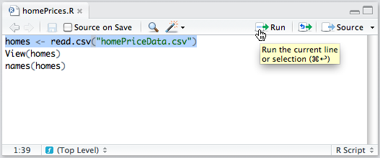
Push Source to run all
the code in the file
Push Run to run a selected
line (or lines) of code

Slide 30
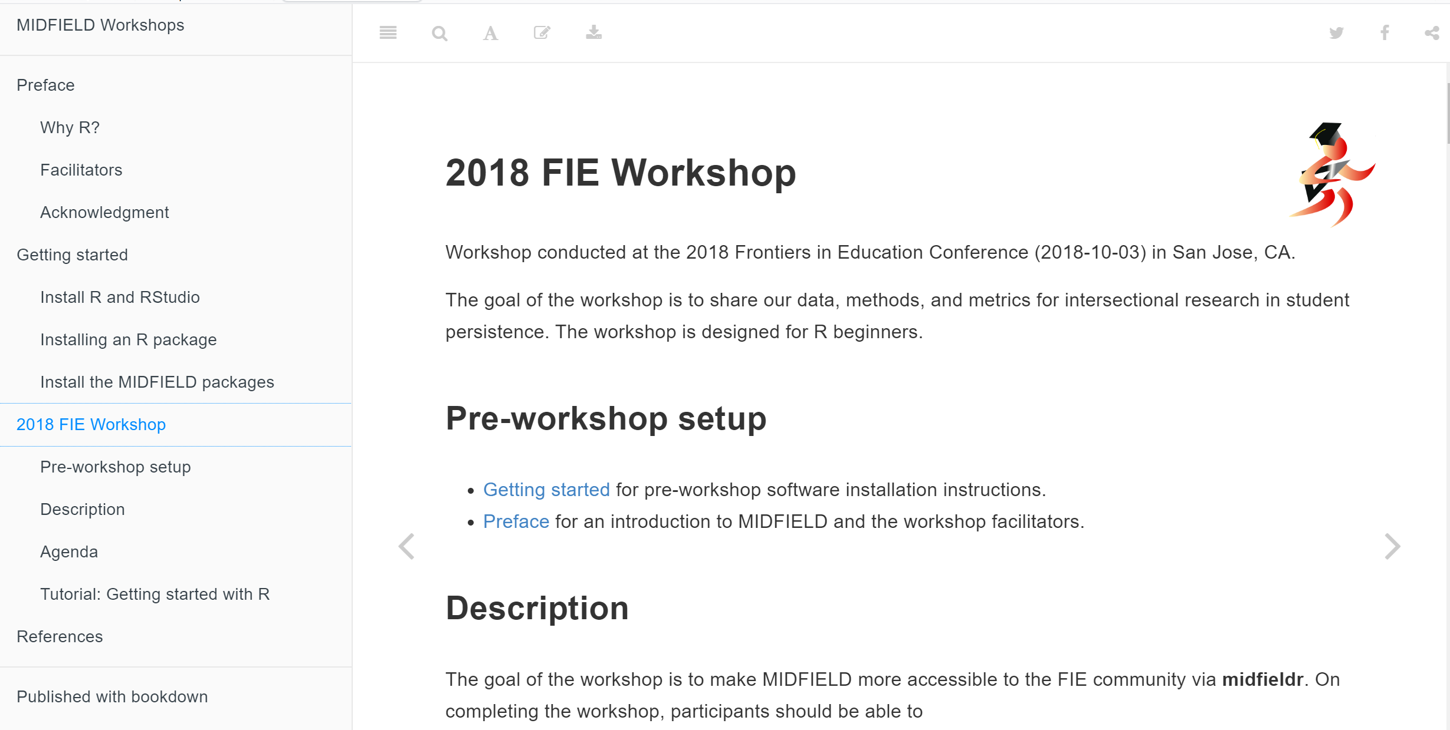

Slide 31
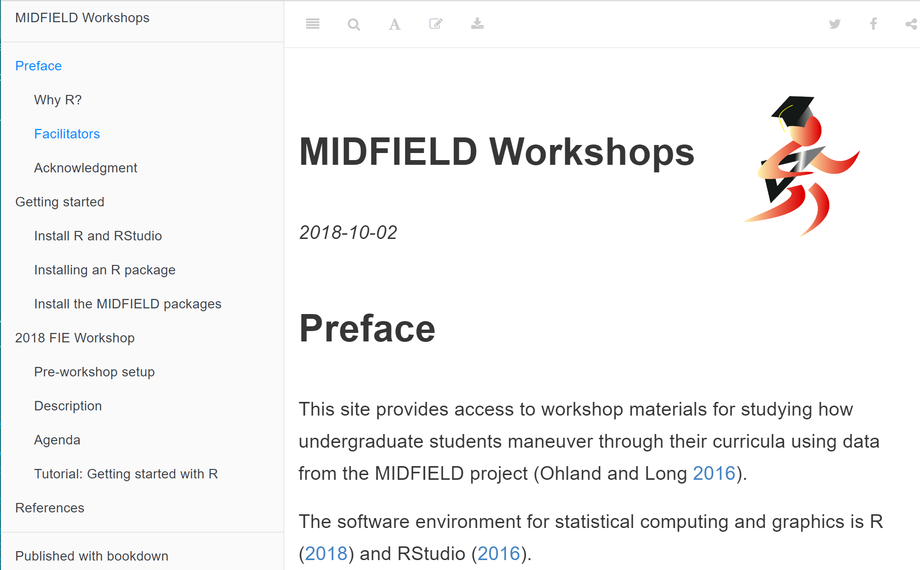

Slide 32
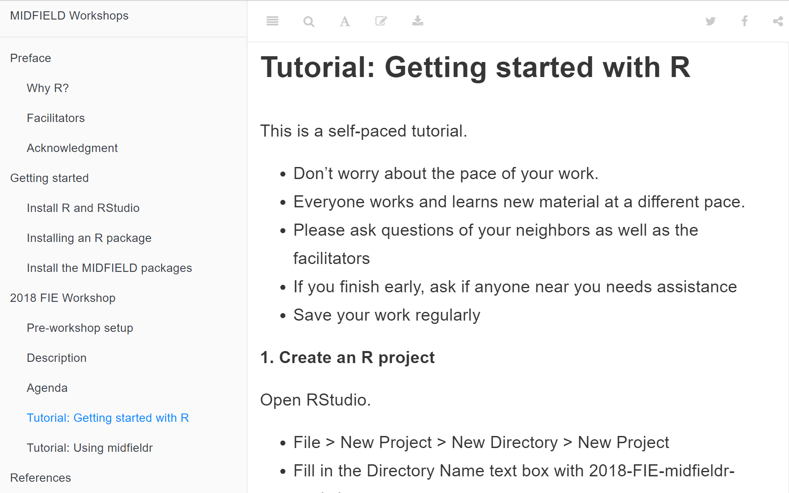

Slide 33
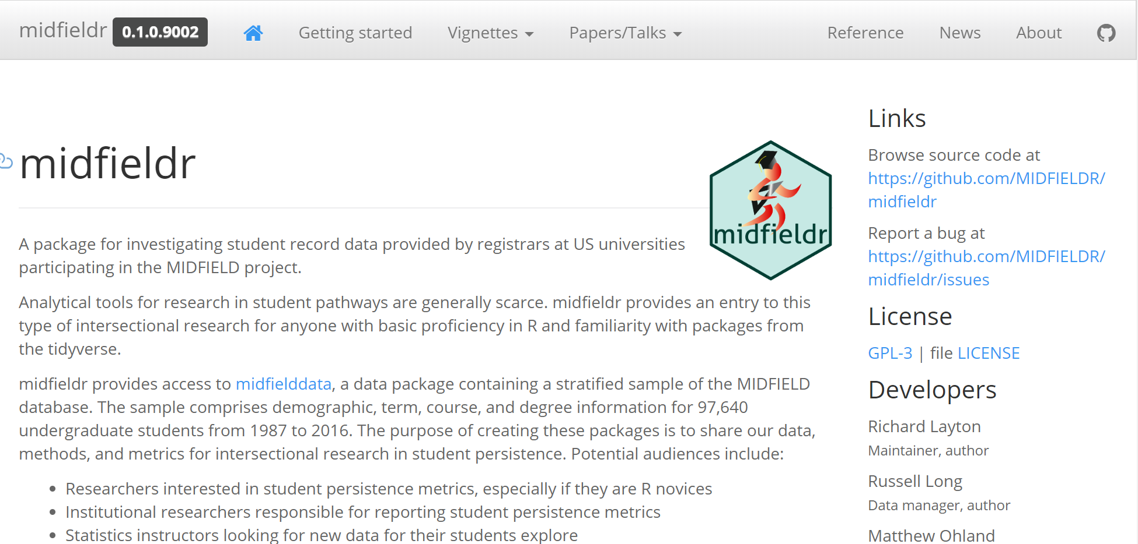

Slide 35
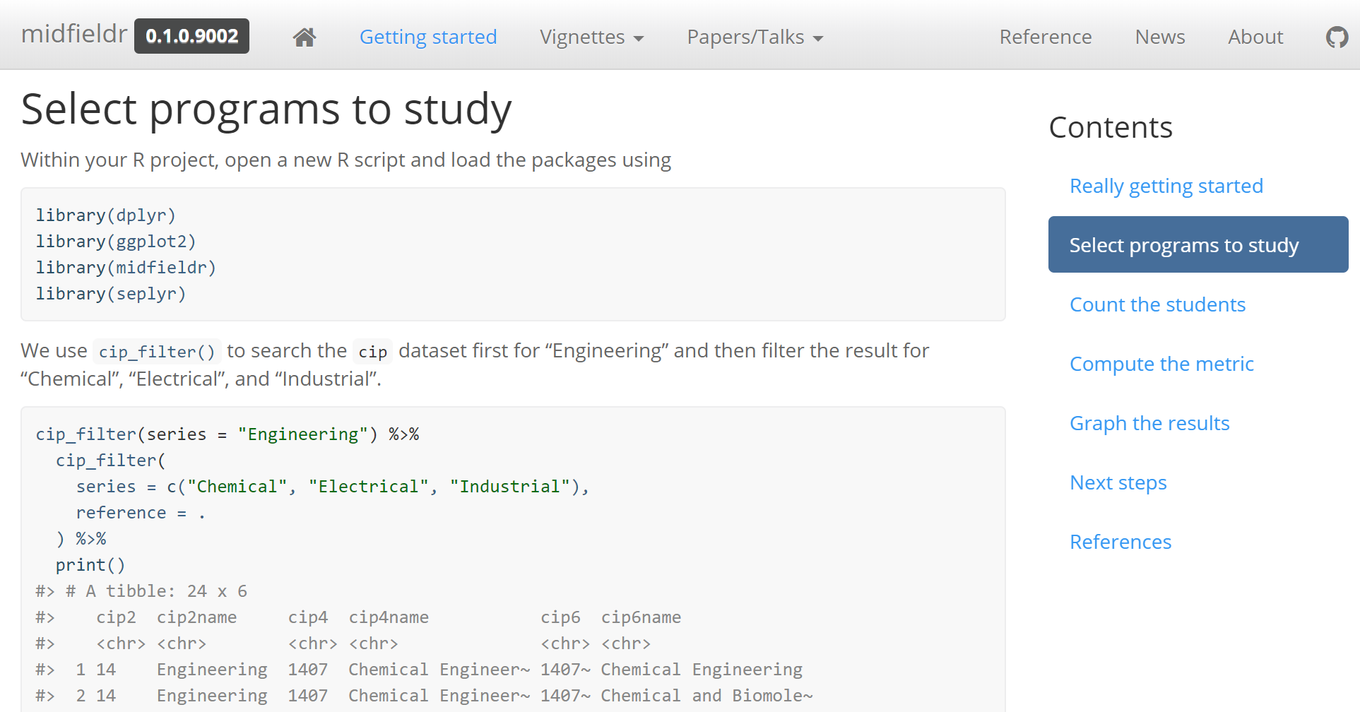

Slide 36
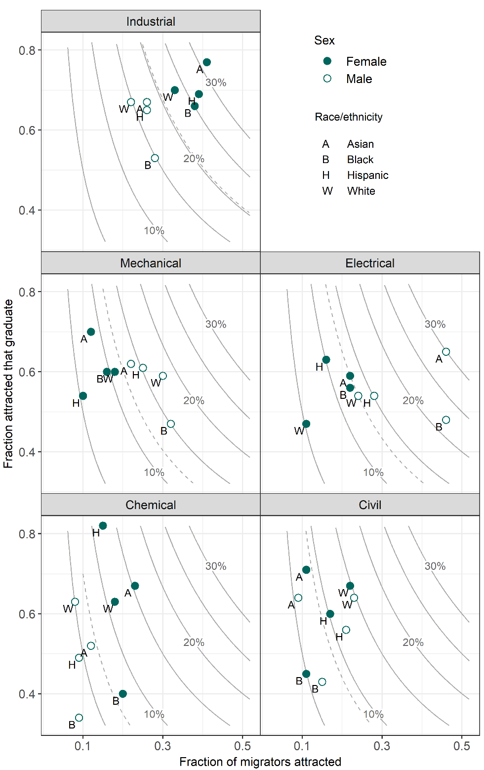

Slide 37
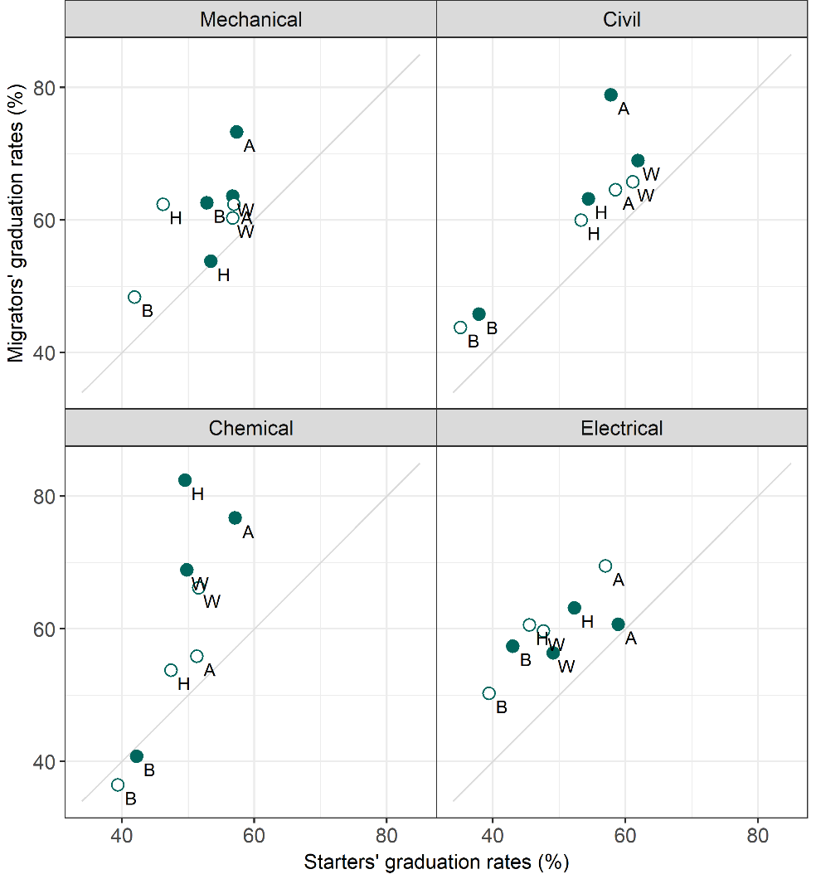

Slide 38
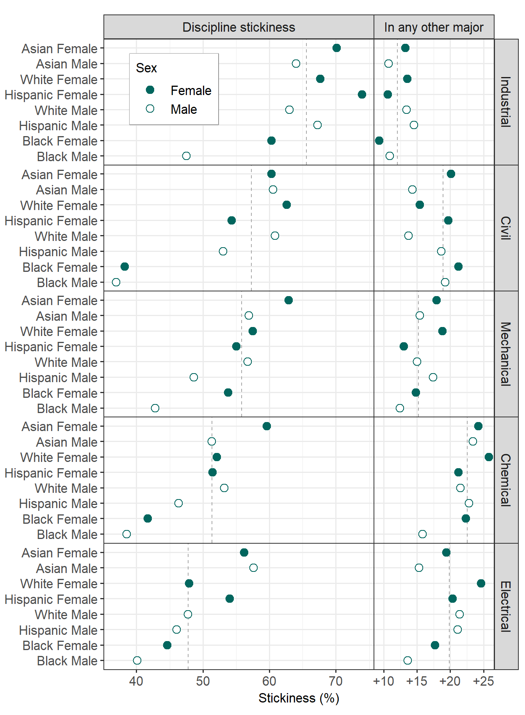

Slide 39
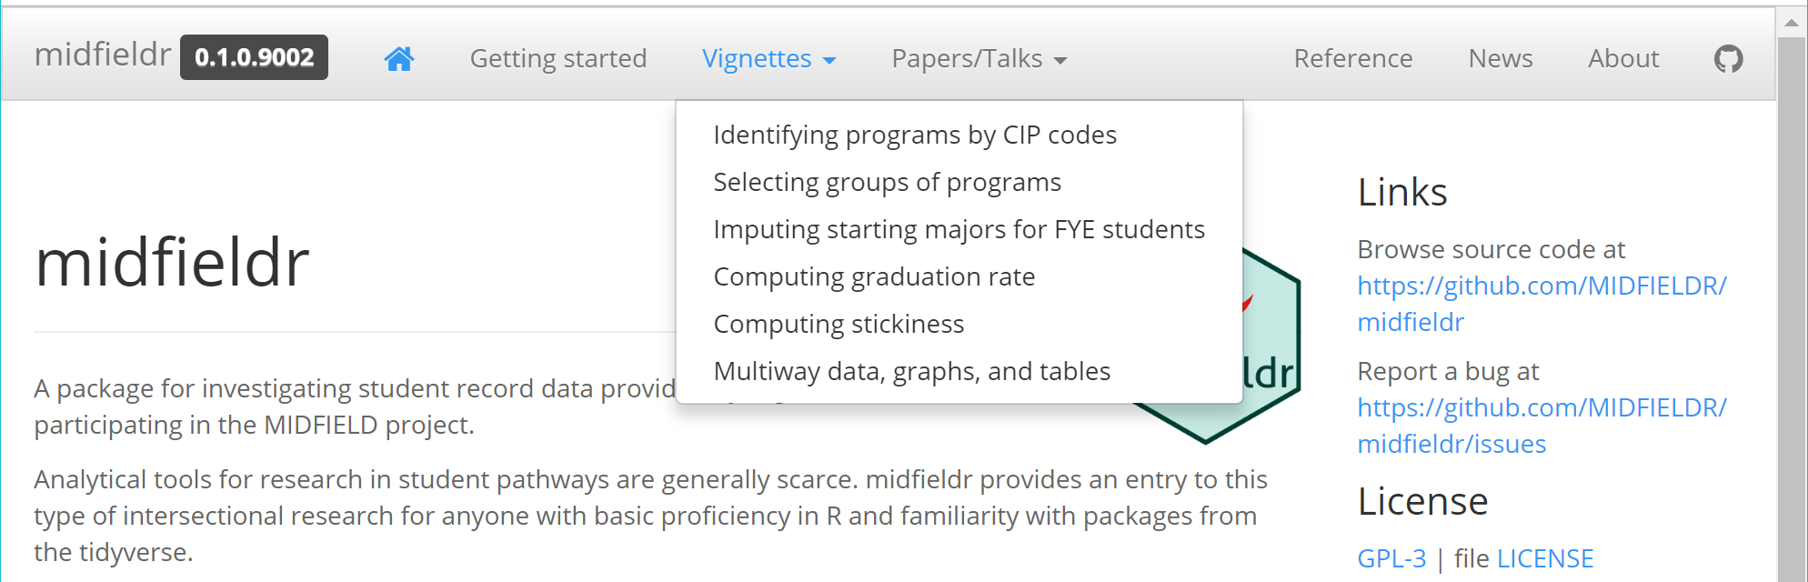

Slide 40
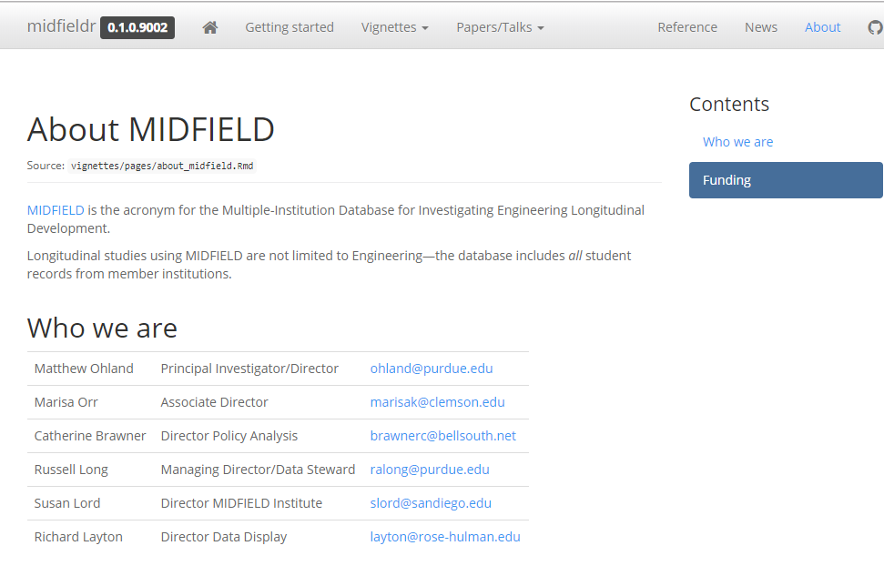

Slide 41
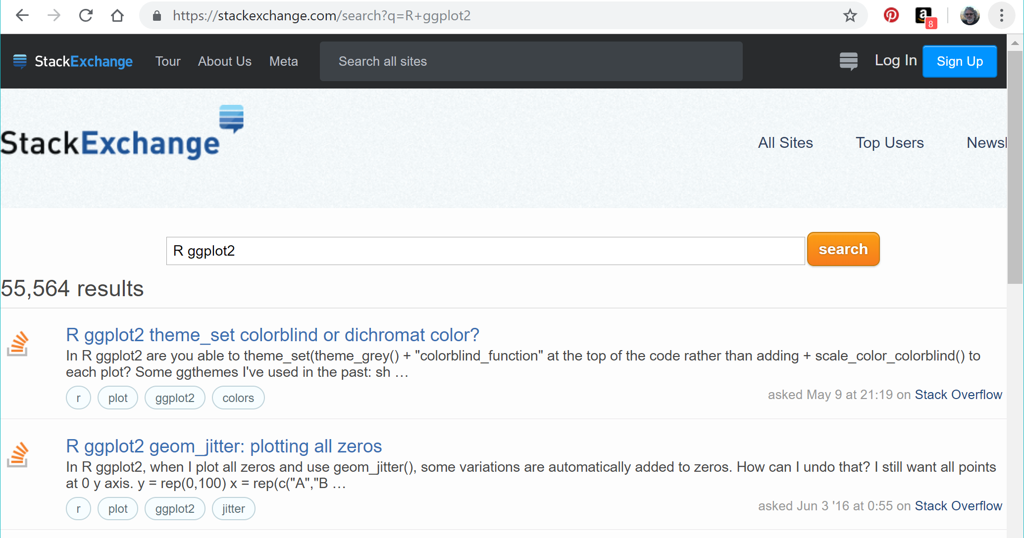

Slide 42
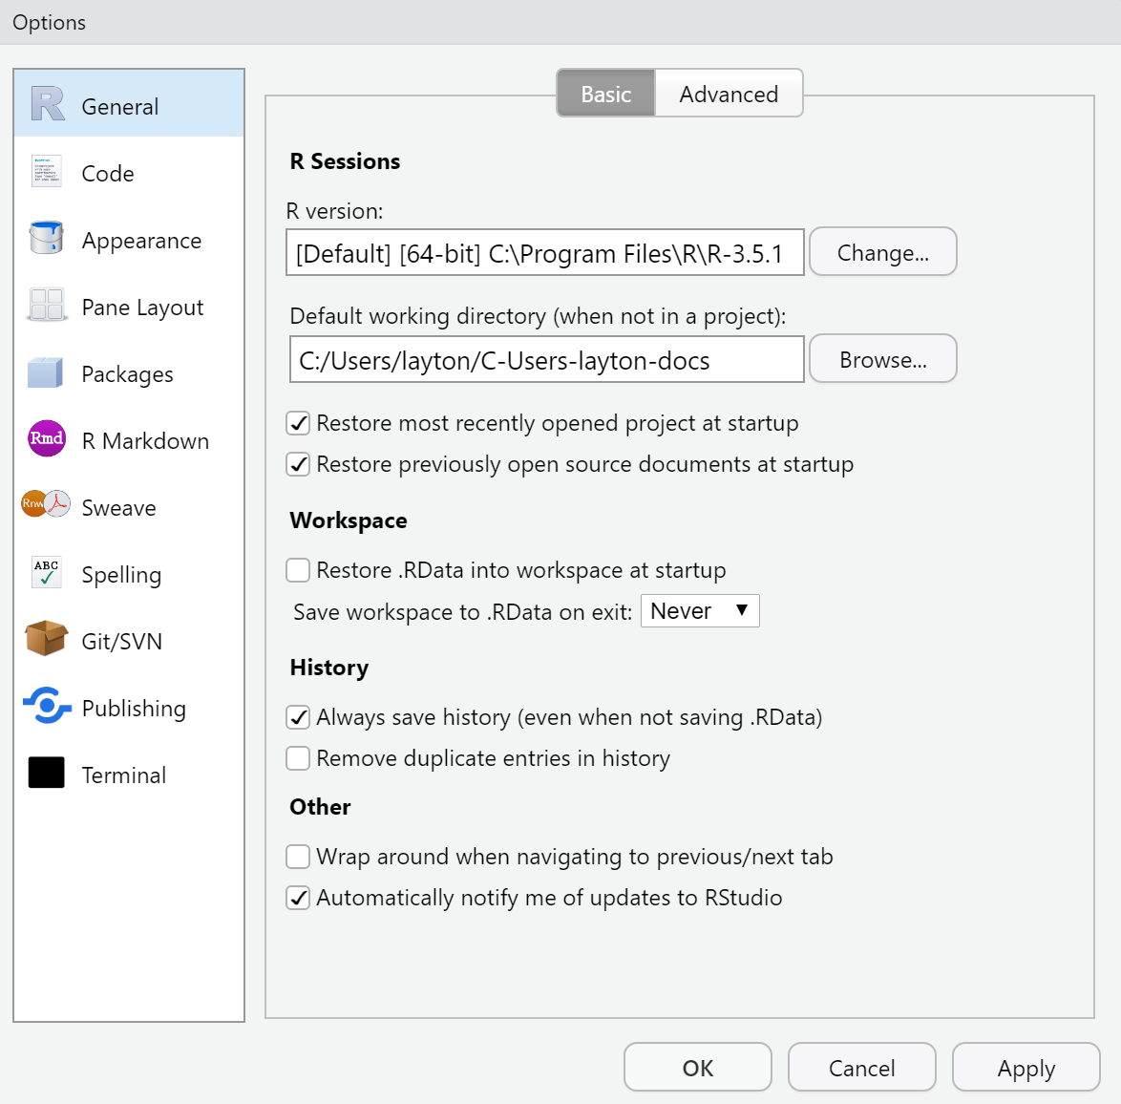

Slide 43
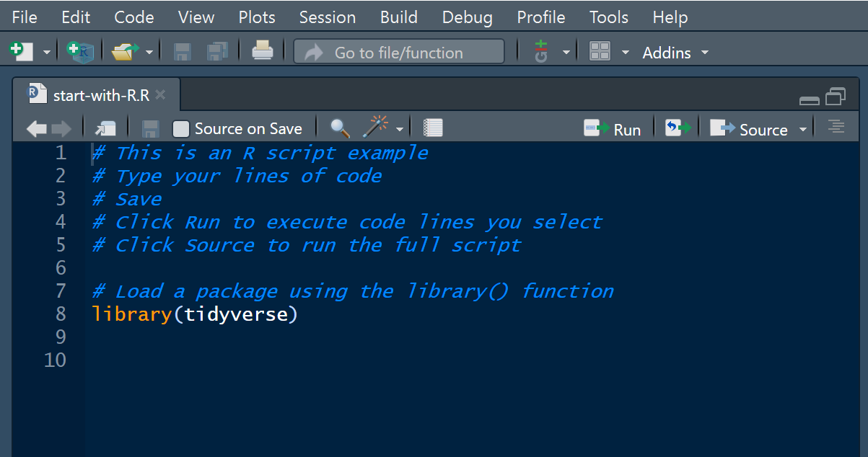
Push Run to run a selected
line (or lines) of code
Push Source to run all
the code in the file

Slide 44
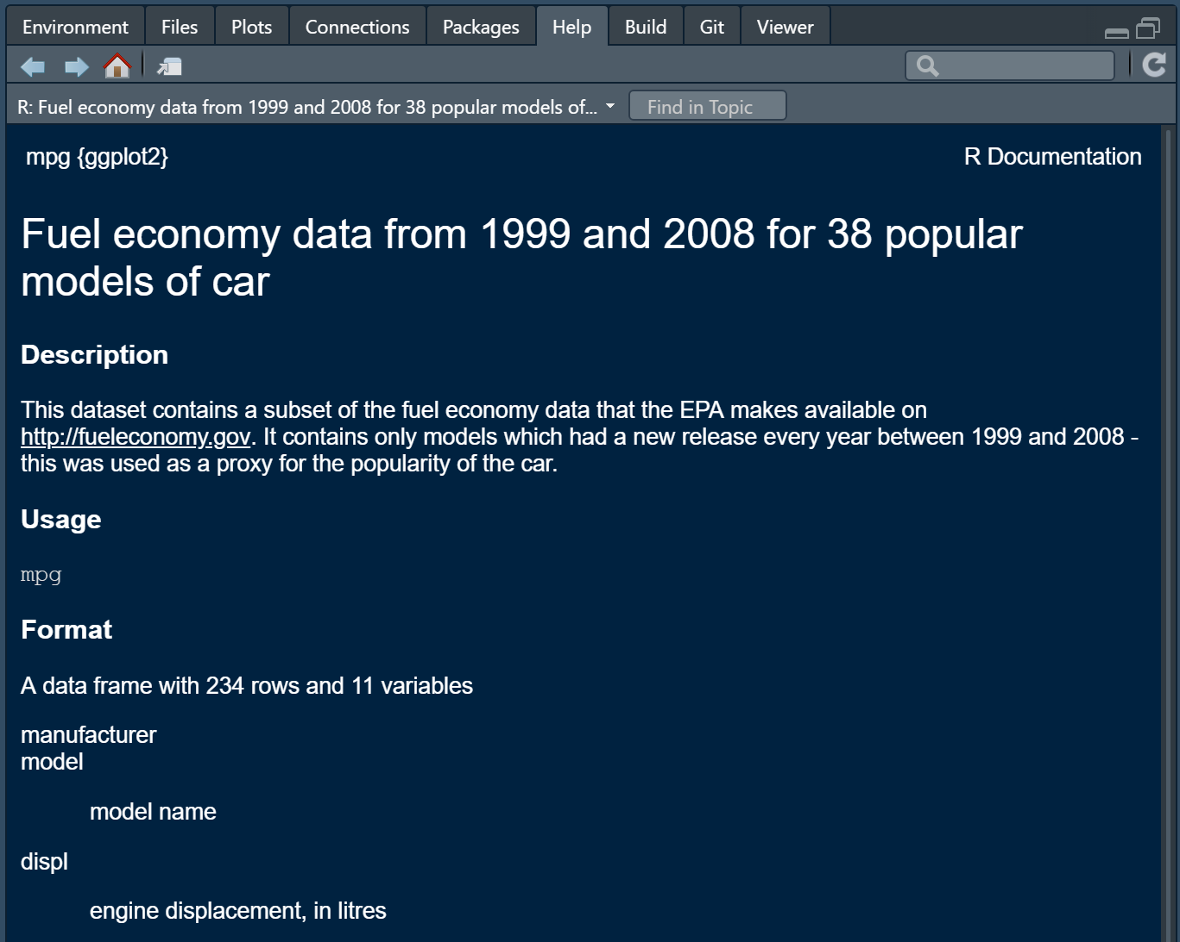
mpg is part of the
ggplot2 package
Name of the
dataset
Describing the
dataset
Explaining the
variable

Slide 45
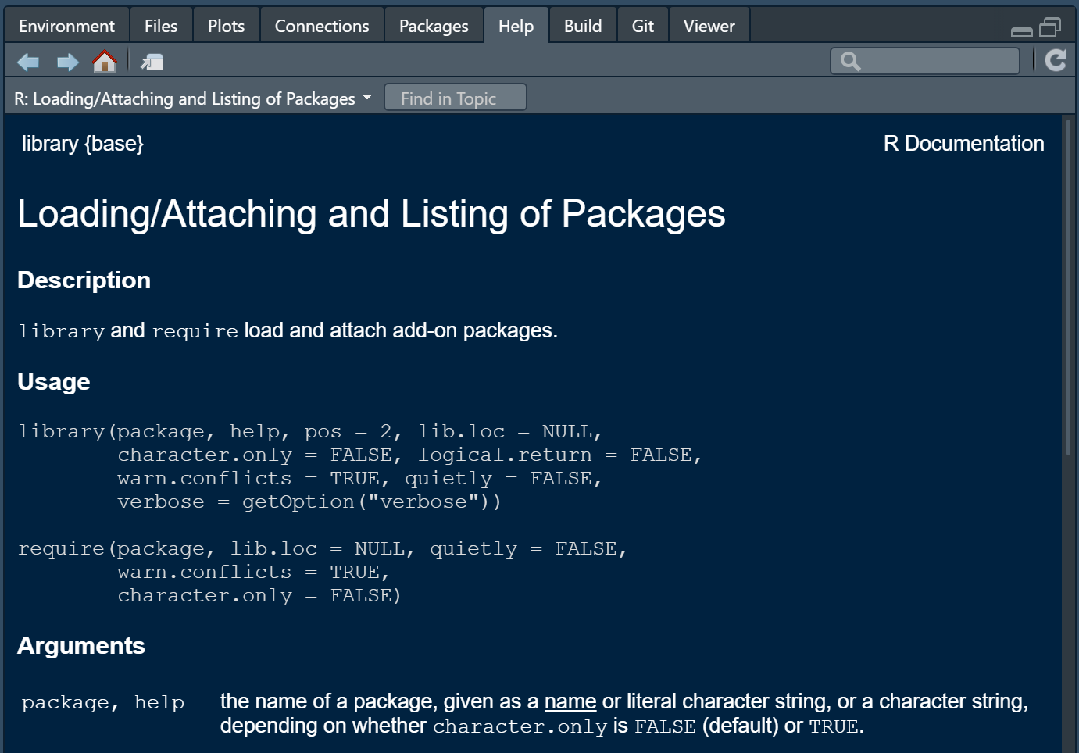
library() is part of the
base R installation
Name of the
function
Listing the
arguments of
the function
Explaining the
arguments

